Slide 1
RFID Based Attendance Management System

Slide 2
Abstract
Radio Frequency Identification based attendance system is an automatic attendance system which consists of a microcontroller, RFID reader, RFID tag and a database as its primary components.
RFID tag serves as a unique identification card for each student.
A student places his identification card in the proximity of an RFID reader which detects the unique ID and student details present in the identification card.
Details of the students are stored in a database.
This data can be used to record and maintain the attendance of the students in class.
The attendance data can be seen through the attendance management system website by Admin, faculty or students.

Slide 3
Problem Statements
To collect and file student attendance, teachers require a student attendance sheet and later they have to enter the data in the Excel sheet.
Loss of instructional time production to search students on the attendance sheet.
More chance of loss of attendance sheet in the traditional attendance system.
Statistical information is not easy to derive.

Slide 4
Working
When someone Swipes the RFID card. Then the RFID reader detects the ID card, and it will send the unique card number to the microcontroller via serial terminal.
The microcontroller checks the unique Card number in the database.
If it matches the system records the attendance in the database. And LCD displays 'Your attendance is marked'.
If it doesn't match then the LCD displays 'You are not registered, please contact admin'.
The attendance can be seen by Admin, Faculty, or Student by login in into Attendance Management System Website

Slide 5
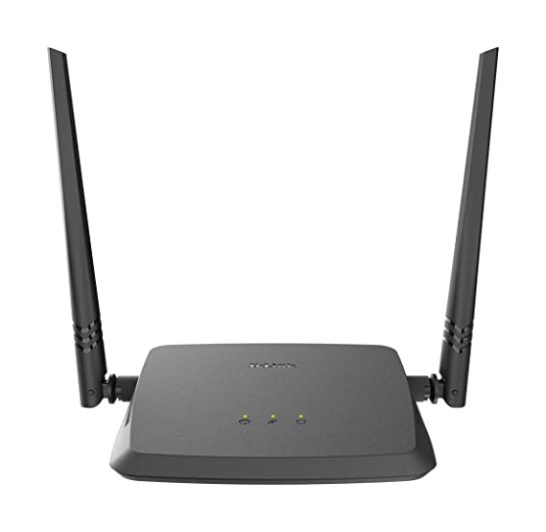
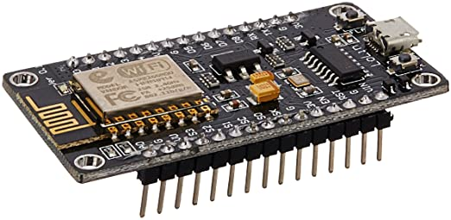

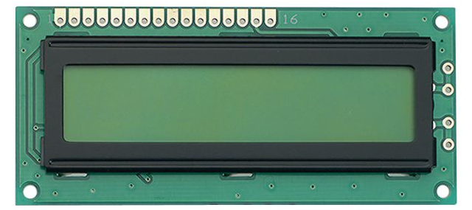
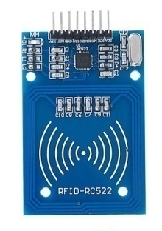

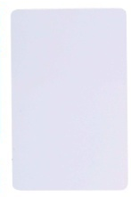
Router
Database
NodeMCU
RFID
Reader
LCD
RFID
Card
Website

Slide 6
Technology Stack
For Website
HTML
CSS
Bootstrap
Php
MySQL
For Programming nodeMCU
Embedded C

